Slide 1
Hormonal Regulation of Reproduction
AEHBY Human Biology

Slide 2
Review
Female Reproductive System label quiz (purposegames.com)
Male Reproductive system label diagram Quiz (purposegames.com)

Slide 3
Learning Intentions
Both male and female reproductive systems are regulated by hormones, including the regulation of the menstrual and ovarian cycles.

Slide 4
Success criteria
Explain why males have continuous reproduction
Explain why females have cyclic reproduction (ie a menstrual cycle)
List the hormones involved in ovulation and menstruation, and for each identify the source, the receptor and the effect of that hormone in the ovulation and menstrual cycles.
Describe the key events in the ovulation and menstrual cycle.

Slide 5
Make a table
Hormone | Source | Function

Slide 6
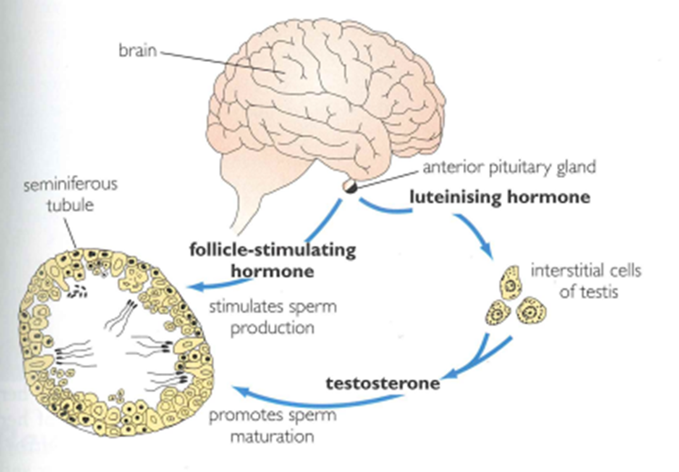
Male hormonal control

Slide 7
Male hormonal control

Slide 8
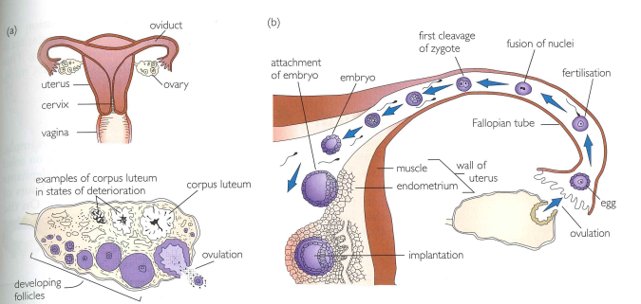

Slide 9
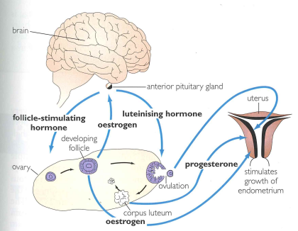
Female hormonal control

Slide 10
Female hormonal control

Slide 11
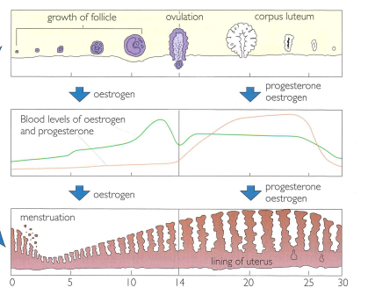

Slide 18
Success criteria
Explain why males have continuous reproduction
Explain why females have cyclic reproduction (ie a menstrual cycle)
List the hormones involved in ovulation and menstruation, and for each identify the source, the receptor and the effect of that hormone in the ovulation and menstrual cycles.
Describe the key events in the ovulation and menstrual cycle.

